Slide 1
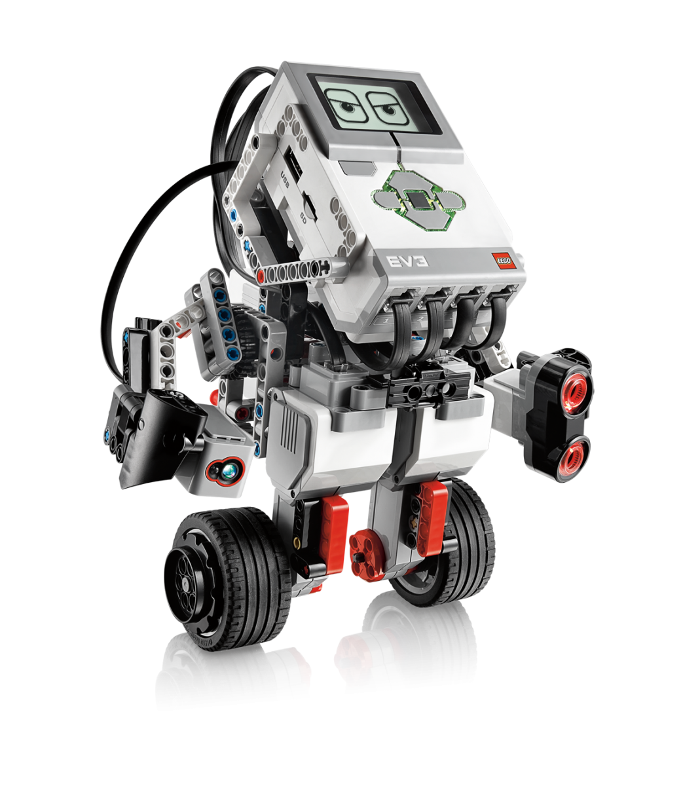
G6 PUT YOUR NAME HERE ROBOTICS PROJECT
Teacher: ____________________
Homeroom:__________

Slide 2
Robotics Project Overview
Here you will find all your worksheets as well as slides you will need to complete for your assessment in this project.
You will be working in pairs to build and program your robot but YOU MUST DO YOUR OWN PORTFOLIO.
Anything in RED in this portfolio are the questions and teachers comments. You must make sure you write your answers and comments in BLACK.
MAKE SURE TO COMPLETE ALL TASKS IN THIS PORTFOLIO AS INSTRUCTED.

Slide 3
Statement of inquiry
Programming a robotic system can have different perspectives, that affect the way it functions.
Inquiry questions
Factual
What can Robots do today?
What are the advantages and disadvantages of using Robots
Conceptual
How can we program the EV3 robots?
How can we assemble an EV3 Robot?
Debatable
CONCEPTS
KEY CONCEPT: Systems
RELATED CONCEPTS: Collaboration , Function
GLOBAL CONTEXT: Scientific and Technical innovation
- Systems, models, methods; products, processes and solutions

Slide 4
Design task
You will Research, Make and Program using software and hardware to program your Robot.
You will be given a few problems and you will have to program your Robot to develop the solutions to the problem.
Areas of assessment
Criterion A:
Inquiring and Analysing
ii. state and prioritize the main points of research needed to develop a solution to the problem
iii. Describe the main features of one existing product that inspires a solution to the problem
iv. present the main findings of relevant research.
Criterion B:
Developing Ideas
i. develop a list of success criteria for the solution
ii. present feasible design ideas, which can be correctly interpreted by others
iii. present the chosen design
Criterion C:
Creating the Solution
i. outline a plan, which considers the use of resources and time, sufficient for peers to be able to follow to create the solution
ii. demonstrate excellent technical skills when making the solution
iii. follow the plan to create the solution, which functions as intended list the changes made to the chosen design and plan when making the solution
iv. present the solution as a whole.
Criterion D:
Evaluating
i. outline simple, relevant testing methods, which generate data, to measure the success of the solution
ii. outline the success of the solution against the design specification
iii. outline how the solution could be improved

Slide 5
Inquiring and Analysing
Criteria A

Slide 6
Task 1A: research Plan
Programming a Robot requires both Hardware and Software for the Robot to work. The Hardware is your “EV3 Robot” and the software is the “Lego Mindstorms EV3” Software used to program it. Find the definitions for Hardware and Software and write them in the boxes below:
HARDWARE
SOFTWARE
Complete the table below by stating the research you will need to undertake to understand how to build and program your Robot.
This is just a guide and you have been given an example in one of the sections. You should try and come up with ATLEAST 3 POINTS IN EACH SECTION FOR A HIGH LEVEL.
 | WHAT HAS TO BE RESEARCHED OR STUDIED? | HOW WILL IT BE RESEARCHED OR STUDIED? | WHAT WILL YOU USE TO FIND OUT
ROBOT
SOFTWARE | What software is available to program my robot? | I will look at the laptops in school and also online to see what is available | Internet, School Laptop
PROGRAMMING

Slide 7
Task 1B: ABOUT ROBOTS
Find out about Robots.
What is a Robot?
What are the disadvantages of robots? Explain your answer.
When were Robots invented?
Find an image of a Robot you like and put it here
What can Robots do?
What are the benefits of robots? Explain your answer.

Slide 8
Task 2A: research on EV3 Robot
Label at least 8-10 different parts and components of the EV3 Robot. Then explain briefly using the PAGE 4 from the Mindstorm help manual what that part does. To Download the Manual CLICK HERE One has been done for you:
EV3 Brick
Carries the battery pack of the robot and controls the robot.
There is 1 sensor missing on the robot. Can you find it and add an image and description of the sensor below
IMAGE OF SENSOR GOES HERE
Name:
Description:
If you were to improve the DESIGN and FUNCTION of this robot what would you do? Explain at least 5 things and explain why you would make these changes:

Slide 9
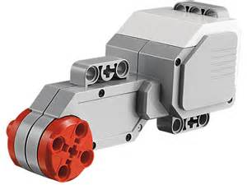
Task 3a: research on robot parts
Label at least 8-10 different parts and components of the EV3 Robot. Then explain briefly using the PAGE 10-12 Mindstorm help manual what that part does. One has been done for you:
What level of degree accuracy does the motor have?
What will the “Move Steering” or “Move Tank” command do to the motors?
The ……….. …………….. is a digital sensor that can detect the ………. ….. ……………. of light that enters the small window on the face of the sensor.
What 3 different modes can this sensor be used?
1.
2.
3.
How many Colours does the sensor recognize? State them below:
NAME?
NAME?
The ………. …………… also includes a …………………………Sensor?
What does this mean for this motor?
What can this motor be programmed to do?
What type of sensor is this? Digital or Analog?
What 3 input conditions does this sensor accept?
1.
2.
3.
NAME?
NAME?

Slide 10
Task 3b: research on robot parts
Label at least 8-10 different parts and components of the EV3 Robot. Then explain briefly using PAGE 13 & 15 from the Mindstrom help manual what that part does. One has been done for you:
The …………….. …………… is a ……… sensor that can detect ……………. light ……………….. from solid objects
What 3 different modes can this sensor be used?
1.
2.
3.
Explain how the first mode works?
What values does the sensor report between?
How far can this sensor detect?
What are the numbered ports used for?
What type of cables are used to connect the sensors to the ports?
If you do not assign the ports that you want the sensors to be connected to what are the default ports:
Port 1:
Port 2:
Port 3:
Port 4:
What will happen if you do not put the sensors in the default ports?/
NAME?
NAME?
What are the lettered ports used for?
If you do not assign the ports that you want the motors to be connected to what are the default ports:
Port A:
Port B and C:
Port D:
NAME?

Slide 11
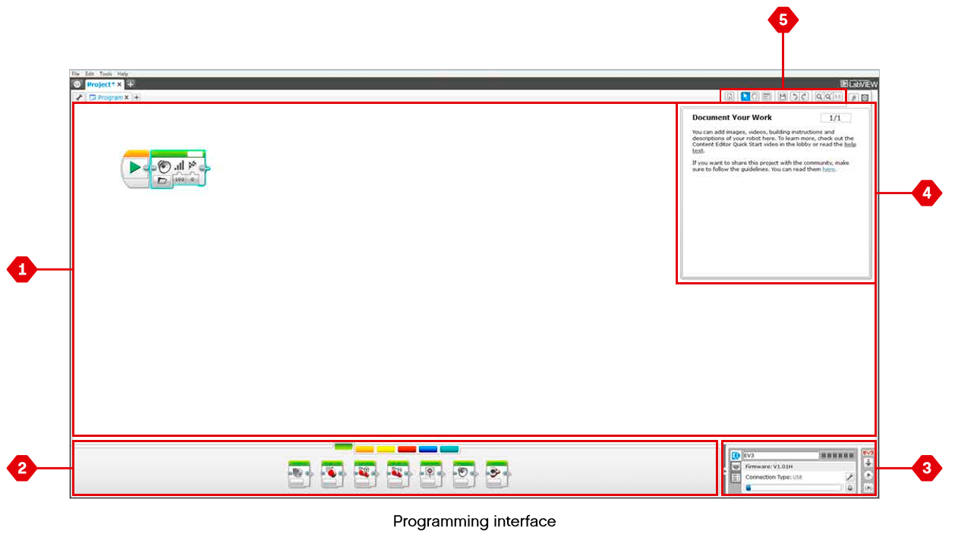
Task 4a: research on software
Open up the “LEGO MINDSTORMS EV3” software you will be using to program your robot. Use the help Manual on PAGE 35 to help you describe the labels to the parts below.
5.
1.
2.
3.
4.

Slide 12
Task 4B: research on software
Open up the “LEGO MINDSTORMS EV3” software you will be using to program your robot and open the help manual.
Question 1: Label what type of programming category each colour represents:

Slide 14
Assessment criteria
& TEACHER’S MARKS
Criterion A:
Inquiring and Analysing
ii. state and prioritize the main points of research needed to develop a solution to the problem
iii. Describe the main features of one existing product that inspires a solution to the problem
iv. present the main findings of relevant research.
.
Criteria | Tasks | 1-2 | 3-4 | 5-6 | 7-8
ii. state and prioritize the main points of research needed to develop a solution to the problem | Task 1 | • states one points of research needed to develop a solution, with some guidance | • states some points of research needed to develop a solution, with some guidance | states and prioritizes the main points of research needed to develop | • states and prioritizes the main points of research needed to develop a solution to the problem, with minimal guidance
iii. Describe the main features of one existing product that inspires a solution to the problem | Task 2 | • states a couple features of an existing product that inspires a solution to the problem | • states the main features of an existing product that inspires a solution to the problem | • outlines the main features of an existing product that inspires a solution to the problem | • describes the main features of an existing product that inspires a solution to the problem
iv. present the main findings of relevant research. | Task 3A Task 3B Task 4A Task 4B | • states the findings of research | • outlines some of the main findings of research | outlines the main findings of relevant research | • presents the main findings of relevant research
Teacher’s Comment

Slide 15
Developing Ideas
Criteria B

Slide 16
Assessment criteria
Developing Ideas
Criterion B:
Developing Ideas
i. develop a design specification which outlines the success criteria for the design of a solution based on the data collected.
iii. present the chosen design and outline the reasons for its selection

Slide 17
Task 5: Write your success criteria
Using your research and analysis of the Hardware and Software, write a list of criteria of what your Robot must have. You must write in full sentences explaining what your Robot should do/have and could do/have.
Remember your specification is a list of bullet points that will state what your produt should be like or have.
For Example:
My Robot must be connected correctly with the wires connected to the right ports.
My Robot SHOULD / COULD / MUST ……..….

Slide 18
Task 6: BUILDING YOUR ROBOT
Working with your partner, use the instruction manual to build your robot. Then take pictures of the completed Robot and place your picture here.
IMAGE OF YOUR BUILT ROBOT GOES HERE.
THEN LABEL PARTS OF YOUR ROBOT.
Explain in your own words the basic steps to building your Robot? Remember to mention the parts to the robot?
Did you have any problems whilst making your robot? Explain them below?
How do you think you performed as partners in this task overall. Talk about the the good things you achieved, what you could improve on for the next task and did you finish on time?

Slide 19
Assessment criteria
& TEACHER’S MARKS
Criterion B:
Developing Ideas
i. develop a design specification which outlines the success criteria for the design of a solution based on the data collected.
iii. present the chosen design and outline the reasons for its selection
Criteria | Tasks | 1-2 | 3-4 | 5-6 | 7-8
i. develop a design specification which outlines the success criteria for the design of a solution based on the data collected. | Task 5 | i. lists a few basic success criteria for the design of a solution. | i. constructs a list of the success criteria for the design of a solution. | i. develops design specifications, which identify the success criteria for the design of a solution | i. develops a design specification which outlines the success criteria for the design of a solution based on the data collected
iii. present the chosen design and outline the reasons for its selection | Task 6 | iii. States one the key features of the chosen design | iii. states the key features of the chosen design | iii. presents the chosen design stating the key features | iii. presents the chosen design describing the key features
Teacher’s Comment

Slide 20
Creating the solution
Criteria C

Slide 21
Areas of assessment
Criterion C:
Creating the Solution
ii. demonstrate excellent technical skills when making the solution
iii. follow the plan to create the solution, which functions as intended list the changes made to the chosen design and plan when making the solution
iv. present the solution as a whole.

Slide 22
TASK 7A: PROGRAMMING YOUR ROBOT
(LEVEL 1 – Movement)
Follow the instructions to program your robot with your partner. Once you have successfully programmed your robot and completed the CHALLENGE task at the end of the tasks, then take a screenshot of your program and place it below. Then answer the reflection questions on the side.
REFLECTIONS
IMAGE OF A SCREENSHOT OF YOUR PROGRAM FROM MINDSTORM GOES HERE.
Explain in your own words what you needed to do to complete this task?
What blocks did you have to use for this task?
Explain any changes you made to the Program or Robot for it to work properly?
PLEASE USE THIS LINK
http://www.education.rec.ri.cmu.edu/content/lego/ev3/preview/
How many times did you test your program?
Did you finish on time?

Slide 23
TASK 7B: PROGRAMMING YOUR ROBOT
(LEVEL 2 - Sensors)
Follow the instructions to program your robot with your partner. Once you have successfully programmed your robot and completed the CHALLENGE task at the end of the tasks, then take a screenshot of your program and place it below. Then answer the reflection questions on the side.
REFLECTIONS
IMAGE OF A SCREENSHOT OF YOUR PROGRAM FROM MINDSTORM GOES HERE.
Explain in your own words what you needed to do to complete this task?
What blocks did you have to use for this task?
Explain any changes you made to the Program or Robot for it to work properly?
PLEASE USE THIS LINK
http://www.education.rec.ri.cmu.edu/content/lego/ev3/preview/
How many times did you test your program?
Did you finish on time?

Slide 24
TASK 7C: PROGRAMMING YOUR ROBOT
(LEVEL 3 – Decisions: Switch-Loops)
Follow the instructions to program your robot with your partner. Once you have successfully programmed your robot and completed the CHALLENGE task at the end of the tasks, then take a screenshot of your program and place it below. Then answer the reflection questions on the side.
REFLECTIONS
IMAGE OF A SCREENSHOT OF YOUR PROGRAM FROM MINDSTORM GOES HERE.
Explain in your own words what you needed to do to complete this task?
What blocks did you have to use for this task?
Explain any changes you made to the Program or Robot for it to work properly?
PLEASE USE THIS LINK
http://www.education.rec.ri.cmu.edu/content/lego/ev3/preview/
How many times did you test your program?
Did you finish on time?

Slide 25
TASK 7D: PROGRAMMING YOUR ROBOT
(LEVEL 4 – Decisions: Line Follower)
Follow the instructions to program your robot with your partner. Once you have successfully programmed your robot and completed the CHALLENGE task at the end of the tasks, then take a screenshot of your program and place it below. Then answer the reflection questions on the side.
REFLECTIONS
IMAGE OF A SCREENSHOT OF YOUR PROGRAM FROM MINDSTORM GOES HERE.
Explain in your own words what you needed to do to complete this task?
What blocks did you have to use for this task?
Explain any changes you made to the Program or Robot for it to work properly?
PLEASE USE THIS LINK
http://www.education.rec.ri.cmu.edu/content/lego/ev3/preview/
How many times did you test your program?
Did you finish on time?

Slide 26
TASK 7E: PROGRAMMING YOUR ROBOT
(LEVEL 5 – FINAL CHALLENGE)
Follow the instructions to program your robot with your partner. Once you have successfully programmed your robot and completed the CHALLENGE task at the end of the tasks, then take a screenshot of your program and place it below. Then answer the reflection questions on the side.
REFLECTIONS
IMAGE OF A SCREENSHOT OF YOUR PROGRAM FROM MINDSTORM GOES HERE.
Explain in your own words what you needed to do to complete this task?
What blocks did you have to use for this task?
Explain any changes you made to the Program or Robot for it to work properly?
PLEASE USE THIS LINK
http://www.education.rec.ri.cmu.edu/content/lego/ev3/preview/
How many times did you test your program?
Did you finish on time?

Slide 27
Assessment criteria
& TEACHER’S MARKS
Criterion C:
Creating the Solution
ii. demonstrate excellent technical skills when making the solution
iii. follow the plan to create the solution, which functions as intended list the changes made to the chosen design and plan when making the solution
iv. present the solution as a whole.
Criteria | Tasks | 1-2 | 3-4 | 5-6 | 7-8
ii. demonstrate excellent technical skills when making the solution | Task 7 | i. demonstrates minimal technical skills when making the solution | ii. demonstrates satisfactory technical skills when making the solution | ii. demonstrates competent technical skills when making the solution | ii. demonstrates excellent technical skills when making the solution
iii. follow the plan to create the solution, which functions as intended list the changes made to the chosen design and plan when making the solution | Task 7 | ii. creates the solution, which functions poorly and is presented in an incomplete form. | iii. creates the solution, which partially functions and is adequately presented | iii. creates the solution, which functions as intended and is presented appropriately | iii. follows the plan to create the solution, which functions as intended and is presented appropriately
iv. present the solution as a whole. | Task 7 | iv. states one change made to the chosen design or plan when making the solution. | iv. states one change in detail made to the chosen design or plan when making the solution. | iv. states one change made to the chosen design and plan when making the solution. | iv. lists the changes made to the chosen design and plan when making the solution
Teacher’s Comment

Slide 28
Evaluating
Criteria D

Slide 29
Areas of assessment
Criterion D:
Evaluating
i. outline simple, relevant testing methods, which generate data, to measure the success of the solution
ii. outline the success of the solution against the design specification
iii. outline how the solution could be improved

Slide 30
TASK 8: TESTING
Take a picture of your Testing Document and place it below. Thereafter answer the questions on the sides.
IMAGE OF YOUR TESTING SHEET.
Testing method (Explain the different ways you tested your Robot and program?) | How good of a testing method was this? (scale between 0 – 5) | Explain why?
What was the total number of times you tested your program in this project?
TOTAL TESTS:

Slide 31
Task 9:
evaluation against success criteria
Copy and paste the success criteria points you made in Task 5 into the first column below then evaluate your Robot/Program.
Success criteria points | Did your final programmed Robot meet the specification point? | How can the Robot be improved to meet the success criteria
 | YES / NO

Slide 32
TASK 10: EVALUATION
Answer the following evaluation questions below about your crazy house below in as much detail as possible. A more detailed answer with explanations of how and why will get you a higher level.
What skills did you learn and use when doing this project? Explain briefly how you programmed your Robot and why you did what you did?
Did you have any main problems whilst programming your Robot and how did you overcome these?
What are the best things you like about your Robot and program? Explain why?
How could you improve your Robot or program if you were to do it again?
What things do you need to practice more and why?

Slide 33
Assessment criteria
& TEACHER’S MARKS
Criterion D:
Evaluating
i. outline simple, relevant testing methods, which generate data, to measure the success of the solution
ii. outline the success of the solution against the design specification
iii. outline how the solution could be improved
Criteria | Tasks | 1-2 | 3-4 | 5-6 | 7-8
i. outline simple, relevant testing methods, which generate data, to measure the success of the solution | Task 8 | i. defines a testing method, which is used to measure the success of the solution | i. defines a relevant testing method, which generates data, to measure the success of the solution | i. defines relevant testing methods, which generate data, to measure the success of the solution | i. outlines simple, relevant testing methods, which generate data, to measure the success of the solution
ii. outline the success of the solution against the design specification | Task 9 | ii. states the success of the solution. | ii. states the success of the solution against the design specification based on the results of one relevant test | ii. states the success of the solution against the design specification based on relevant product testing | ii. outlines the success of the solution against the design specification based on authentic product testing
iii. outline how the solution could be improved | Task 10 | iii. states one way in which the solution could be improved | iii. states one way in detail in which the solution could be improved | iii. outlines one way in which the solution could be improved | iii. outlines how the solution could be improved
Teacher’s Comment

Slide 34
FINAL ASSESSMENT MARK
Criterion A:
Inquiring and Analysing
ii. state and prioritize the main points of research needed to develop a solution to the problem
iii. Describe the main features of one existing product that inspires a solution to the problem
iv. present the main findings of relevant research.
Criterion B:
Developing Ideas
i. develop a list of success criteria for the solution
ii. present feasible design ideas, which can be correctly interpreted by others
iii. present the chosen design
Criterion C:
Creating the Solution
i. outline a plan, which considers the use of resources and time, sufficient for peers to be able to follow to create the solution
ii. demonstrate excellent technical skills when making the solution
iii. follow the plan to create the solution, which functions as intended list the changes made to the chosen design and plan when making the solution
iv. present the solution as a whole.
Criterion D:
Evaluating
i. outline simple, relevant testing methods, which generate data, to measure the success of the solution
ii. outline the success of the solution against the design specification
iii. outline how the solution could be improved
TOTAL MARK (OUT OF 8):

Slide 35
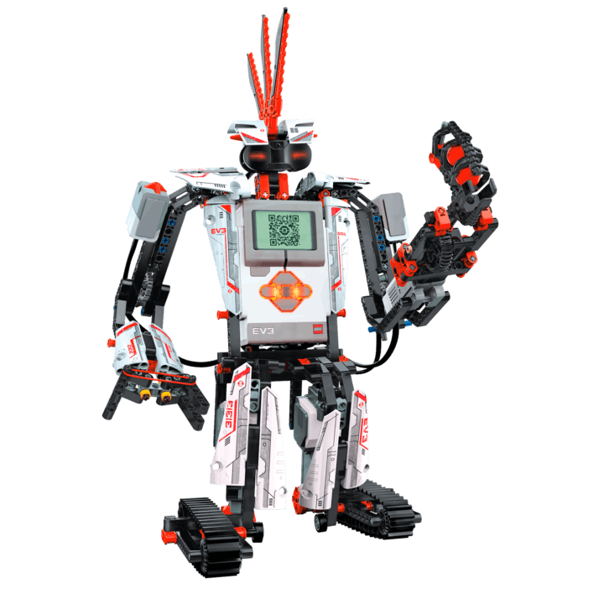
WELL DONE!!! YOU HAVE COMPLETED YOUR PROJECT!

