Slide 1

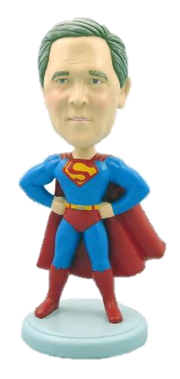

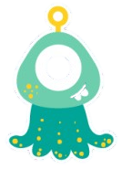
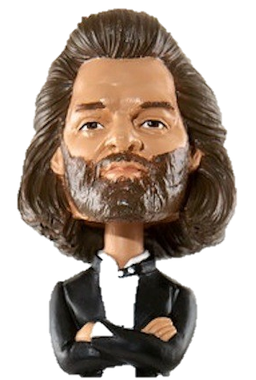
G7
YOUR NAME HERE
3D BOBBLE-HEAD PROJECT
Teacher: ____________________
Homeroom:__________

Slide 2
STATEMENT OF INQUIRY
3D Printing Manufacturing Allows for the Ability to Personalize Products According to Individual Needs and Requirements.
INQUIRY QUESTIONS
Factual:
  What is 3D printing and how does it work?
Conceptual:
  How can we use CAD/CAM to design and make a Bobble-head figurine of high quality.
  How are bobble-heads designed to attract the audience.
Debatable
  To what extent can a 3D printer be used to manufacture products on a large scale?
LEARNER PROFILE
During your work you will have the opportunity to be inquirers, knowledgeable, communicators and open minded.
Concept: Communication
Global Context: Personal and Cultural expression

Slide 3
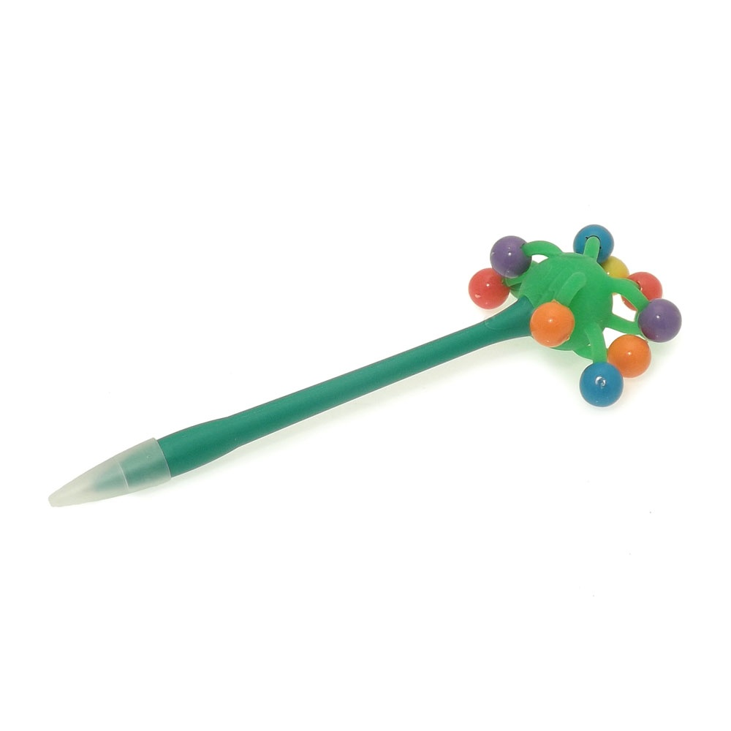
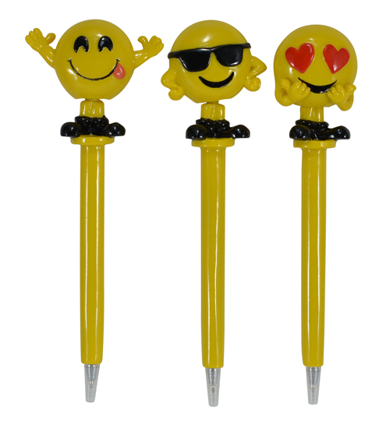
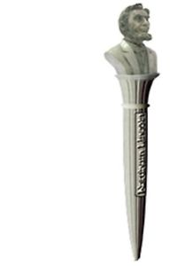
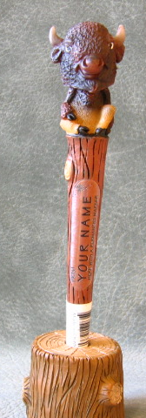
Project Brief
You are a designer for a 3D printing company that creates personalised merchandise bobble-head PENS for consumers, where they print a 3D head of a monster and place it on a different body.
The head of the company is launching a three new themes from which you can choose from: 1.monster theme, 2.African Theme 3.Animal Theme. The head of the company has asked you to design and make a new head/body for the monster/african/animal theme
You are to do the following:
Design and make the themed pen in 3D.
3D print your booble Head to place on the pens body as a prototype example.

Slide 4
DESIGN TASK
You will Research, Design and Make using CAD/CAM a prototype of a Bobble-head monster that can be sold online to consumers.
AREAS OF ASSESSMENT
Criterion A:
Inquiring and Analysing
Explain and justify the need for a solution to the problem.
ii. construct a research plan, which states and prioritizes the primary and secondary research needed to develop a solution to the problem
Criterion B:
Developing Ideas
i. develop a design specification which outlines the success criteria for the design of a solution based on the data collected.
ii. present a range of feasible design ideas, which can be correctly interpreted by others
iii. present the chosen design and outline the reasons for its selection
iv. develop accurate planning drawings/diagrams and outline requirements for the creation of the chosen solution.
Criterion C:
Creating the Solution
i. construct a logical plan, which outlines the efficient use of time and resources, sufficient for peers to be able to follow to create the solution
iii. follow the plan to create the solution, which functions as intended explain changes made to the chosen design and the plan when making the solution.
iv. present the solution as a whole
Criterion D:
Evaluating
ii. explain the success of the solution against the design specification
iii. describe how the solution could be improved

Slide 5
Inquiring and Analysing
Criterion A:

Slide 6
TASK 1A: (RESEARCH) ABOUT 3D PRINTING
Fill in the missing spaces using the words below. Use this link to help you:
https://www.3dhubs.com/what-is-3d-printing#a-brief-history-of-3d-printing
3D Printing is an additive _____________ process that creates a _____________ object from a ____________ design. There are different 3D printing ______________ and ________________ you can print with, but all are based on the same principle: a digital model is turned into a solid three-dimensional physical object by adding material ___________ by layer.
Layer manufacturing digital materials physical technologies
Below research and find 2 methods of 3D printing.
3D METHOD 1
3D METHOD 2
NAME OF 3D PRINTING METHOD:
DESCRIPTION:
IMAGE OF PRINTING METHOD:
NAME OF 3D PRINTING METHOD:
DESCRIPTION:
IMAGE OF PRINTING METHOD:

Slide 7
TASK 1B: (RESEARCH)
3D PRINTING TO SOLVE PROBLEMS.
Find 3 products that were made using a 3D printer. Then answer the questions about them below:
IMAGE OF PRODUCT
MADE USING 3D PRINTING
IMAGE OF PRODUCT
MADE USING 3D PRINTING
Describe the product in full sentences?
Describe the product in full sentences?
What method or material of 3D printing was used to make the product?
What method or material of 3D printing was used to make the product?
How has the product benefitted the world?
How has the product benefitted the world?
Could this product be made without 3D printing? Explain your answer
Could this product be made without 3D printing? Explain your answer

Slide 8
TASK 2a: SITUATION ANALYSIS / RESEARCH PLAN
Below is an example of how to analyse your situation through a research plan. You need to do this for all the CAFQUES headings. Only some of them have been shown below:
Generic Area | What has to be Researched? | How will it be researched? | Is it Primary or Secondary Research?
COST | How much will it cost to make my website? | Internet Research/ Asking Experts | Secondary/ Primary
AESTHETICS
FUNCTION
MAKING (Software, Hardware)

Slide 9
TASK 2b: SITUATION ANALYSIS / RESEARCH PLAN
Generic Area | What has to be Researched? | How will it be researched? | Is it Primary or Secondary Research?
USER
ETHICAL ISSUES
SAFETY (e-safety)

Slide 10
TASK 3: (RESEARCH)
PRODUCT ANALYSIS
Analyse 2 different Bobble-head products. Get an image of your Bobble-head product on the next page and use the headings below to analyse it? You will find and analyse 2 existing Bobbleheads using your CAFEQUES criteria below:
These headings and questions should help you remember how to effectively analyse and evaluate products. Read through this slide then answer the questions on the next slide.
Cost
How much does the product cost and is it good value for money?
Size / Ergonomics
Is the product comfortable to use?
To what extent has the designer considered human factors (ergonomics) in the product’s design?
If you increase or decrease the product’s scale, would it work or look better?
User
Who is the product designed for (the target market)?
Why would they use the product?
What impact will it have on the consumers quality of life?
How is the product promoted to attract its customers?
Aesthetics
Does the product look good?
Does it make good use of colour and texture?
Has it got a good quality finish?
Environment
Can you think of any impacts the product or use of the product may have on the environment?
Think about its manufacture, general use and final disposal when its not needed.
Manufacturing
/Quality
What is the product made from?
Would another type of material work better?
Function
Does the product do the job for which it was intended?
How well does the product work?
Could it be improved?
Safety
How has the designer considered the safe use of the product?
Think about who may be using it (ages) and how different parts have been joined together?
Does the product meet safety standards for children?

Slide 11
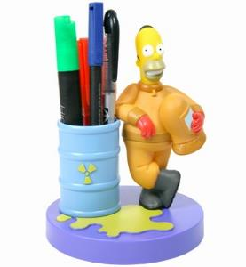
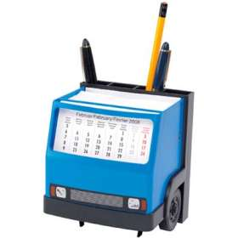
EXAMPLE PRODUCT ANALYSIS
Homer Simpson Talking Plastic Desk Tidy
C: £11.99 which I feel is a fairly reasonable price considering the amount of detail in the design.
A: Very bright and colourful which interesting design ideas.
F: It is a fairly large product but the amount of storage space is quite limited.
E: Smooth plastic texture which will not knock over easily.
Q: Looks high quality and well manufactured.
U: Aimed at children under 16
E: Made from thermoplastic which can be recycled after use.
S: All pieces are firmly attached and there are no small gaps or choke hazards.
Lorry Loader Desk Tidy
C: £27.50 which I feel is a high price for this item.
A: Interesting design but the colours are a bit dull.
F: It has a calendar built into the windshield and good dividers for the stationery items, but limited space.
E: a bit lumpy and looks unstable
Q: Looks a bit cheap even though it is made form metal (steel) and plastic.
U: Aimed at a male audience probably for young adults upwards.
E: Made from metal and thermosetting plastic so tricky to recycle.
S: Has some quite sharp edges that could hurt a child.

Slide 12
TASK 3A: PRODUCT ANALYSIS 1
Cost
IMAGE OF YOUR PRODUCT GOES HERE
Environment
Aesthetics
Size / Ergonomics
User
Manufacturing
Function
Safety

Slide 13
TASK 3B: PRODUCT ANALYSIS 2
Cost
IMAGE OF YOUR PRODUCT GOES HERE
Environment
Aesthetics
Size / Ergonomics
User
Manufacturing
Function
Safety

Slide 14
TASK 4: JUSTIFYING THE NEED
Explain and Justiy the need for your Bobble-head?
First explain the Problem (you must think of this yourself)…why does the company want to make a monster themed bobble-head?
Then explain and justify Why is it important for you to make a Bobble-head? What benefits will it bring to the company and the target user? (Below is an example of the command terms showing the difference between Explaining something and Justifying it.
Paragraph 1:
The problem….
Paragraph 2:
The solution to the problem is….
The benefits it will bring the company are…..
The benefits it will bring the consumer or target market are….

Slide 15
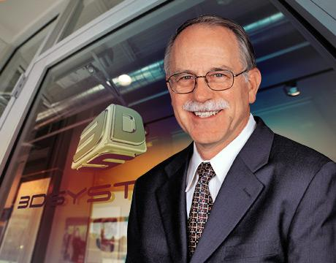
TASK 5A: (RESEARCH)
HISTORY OF 3D PRINTING
Create a timeline showing the history of 3D printing. You can use images to help show it.
1984
Charles Hull invents Stereolithography a type of 3D system. The birth of 3D printing

Slide 16
TASK 5B: (RESEARCH)
WHO IS USING 3D PRINTING?
Create a mind map showing some of the common examples of people that use 3D printing. Use this link https://www.3dhubs.com/what-is-3d-printing#how-does-3d-printing-work to help you. For a higher level give a brief summary of at least 5 different types of people and how they use 3D printing.
WHO IS USING 3D PRINTING?

Slide 17
TASK 5C: (RESEARCH)
TYPES OF 3D PRINTING
Create a mind map showing some of the common types of 3D printing. Use this link https://www.3dhubs.com/what-is-3d-printing#technologies to help you.
For a higher level give a brief summary of at least 2 different types of 3D printing. You must describe the Material jetting method:
TYPES OF 3D PRINTING METHODS

Slide 18
TASK 5D: (RESEARCH)
3D SOFTWARES
Create a mind map showing some of the common software's used for 3D printing. Use this link https://www.3dhubs.com/what-is-3d-printing#how-can-i-get-3d-printable-designs to help you.
Can you state which plastic you will use and give a description of it? Why do you think we use this plastic? What properties does it have? What products is it used for?
3D SOFTWARES

Slide 19
TASK 6: WRITE A DESIGN BRIEF
Write a detailed statement along with 4/5 main points to consider for what you need to do to create a solution for your problem. The Design Brief is a short statement of what you are going to make, why you are going to make it, and for whom you are making it for. It should be an open ended statement.
A good Design Brief might be something like this...
"Teenagers have very busy lives. School, family and social activities mean that being punctual is very important.
I will design and make a wall clock that will be appealing for teenage girls. It will be a modern design and will be suitable for a teenage girl's bedroom. Because the design will appeal to teenage girls, them they will be more likely to look at it, read the time and therefore not be late.
A poor example would be something like this:
" I will make a football clock from plastic and print out pictures of players to use as the numbers."
DESIGN BRIEF
WHAT are you making? (explain briefly)
My brief is to……………………………………
WHO are you making it for? (eg: target market and head of company)
WHY are you making it? (eg: for the company, what problem they currently have and what benefit it will have for them?)
WHEN will you make it by? (eg: your deadline)
HOW will you make it (eg: what machinery will you use, method of constructing it)
After you have completed your brief in the box above. Delete all the red comments and questions so you are left with approx. 5 statements. This will form your brief.

Slide 20
ASSESSMENT CRITERIA & TEACHER MARK
Criteria | Tasks | 1-2 | 3-4 | 5-6 | 7-8
i. explain and justify the need for a solution to a problem for a specified client/target audience | Task 4 | i. states the need for a solution to a problem for a specified client/target audience | i. outlines the need for a solution to a problem for a specified client/target audience | i. explains the need for a solution to a problem for a specified client/target audience | i. explains and justifies the need for a solution to a problem for a client/ target audience
ii. identify and prioritize primary and secondary research needed to develop a solution to the problem | Task 1A Task 2A Task 2B Task 5A-5D | ii. outlines a research plan | ii. outlines a research plan, which identifies primary and secondary research needed to develop a solution to the problem, with some guidance | ii. constructs a research plan, which identifies and prioritizes primary and secondary research needed to develop a solution to the problem, with some guidance | ii. constructs a detailed research plan, which identifies and prioritizes the primary and secondary research needed to develop a solution to the problem independently
iii. analyse a range of existing products that inspire a solution to the problem | Task 1B Task 3A Task 3B | iii. outlines one existing product that inspires a solution to the problem | iii. outlines and describes one existing product that inspires a solution to the problem | iii. describes a group (3-4) of similar products that inspire a solution to the problem | iii. analyses in detail a group (3-4) of similar products that inspire a solution to the problem
iv. develop a design brief, which presents the analysis of relevant research. | Task 6 | iv. develops a basic design brief, | iv. develops a basic design brief, which outlines some of relevant research. | iv. develops a design brief, which outlines the findings of relevant research. | iv. develops a detailed design brief, which summarizes the analysis of relevant research.
Teacher’s Comment | 6U1.3

Slide 21
Developing Ideas
Criterion B:

Slide 22
AREAS OF ASSESSMENT
Criterion A:
Inquiring and Analysing
iii. analyse a group of similar products that inspire a solution to the problem
iv. develop a design brief, which presents the analysis of relevant research.
Criterion B:
Developing Ideas
i. develop a design specification which outlines the success criteria for the design of a solution based on the data collected.
ii. present a range of feasible design ideas, which can be correctly interpreted by others
iii. present the chosen design and outline the reasons for its selection
iv. develop accurate planning drawings/diagrams and outline requirements for the creation of the chosen solution.
Criterion C:
Creating the Solution
i. construct a logical plan, which outlines the efficient use of time and resources, sufficient for peers to be able to follow to create the solution
iii. follow the plan to create the solution, which functions as intended explain changes made to the chosen design and the plan when making the solution.
iv. present the solution as a whole
Criterion D:
Evaluating
ii. explain the success of the solution against the design specification
iii. describe how the solution could be improved

Slide 23
TASK 4:
WRITE A DESIGN SPECIFICATION
Using your research and analysis of the products, write a list of criteria of what your product must have. You can use the questions below to help you. You must write in full sentences explaining what your product should do/have and could do/have.
SUGGESTIONS: A. Write a rough specification first and ask other pupils / teachers to read it. B. Look carefully at each statement and keep the English as clear and simple as possible. C. Limit the statements to between 7 to 12 points (maximum). D. Ensure most points refer directly to your research.
Remember your specification is a list of bullet points that will state what your produt should be like or have.
For Example:
The Bobble-head should have a good quality finish.
The Bobble-head should accommodate and be spacious enough for 1 person…..etc
You sentences should start with…
The Bobble-head will….
The Bobble-head Should…
The Bobble-head Could…..
The Bobble-head must….

Slide 24
MOODBOARD
Find images of West african art from your book “Things fall apart”and bobble pens you like. Then create a collage of them here. Some key-words you could google are:
Kente cloth
Djembe
Igbo
Yoruba
West African Art
Ghananian
Ashanti
Egwugwu
Cote d’ivoire
Things fall apart
Chinua Achebe

Slide 25
DESIGN SPECIFICATION
Make sure to start all your sentences with:
My product SHOULD / COULD / MUST / ….
AESTHETICS
My product should…..
FUNCTION
MATERIALS
MANUFACTURE
USER
SIZE
SAFETY

Slide 26
TASK 5: DESIGN IDEA 1&2
Sketch your Bobble-head monster designs on the worksheet “Design Ideas”. Then take good quality pictures of your design ideas and put them below. Make sure to analyse them properly.
1. What do you like about the design? 2, What do you dislike about your design? 3. What do you think of the colour scheme? 4. How can you improve the design?
5. Does your design meet your specification points, explain a few that meet it and some that do not meet it?
________________________________________________________________________________________________________________________________________________________________________________________________
________________________________________________________________________________________________________________________________________________________________________________________________

Slide 27
DESIGN IDEA 3&4
1. What do you like about the design? 2, What do you dislike about your design? 3. What do you think of the colour scheme? 4. How can you improve the design?
5. Does your design meet your specification points, explain a few that meet it and some that do not meet it?
________________________________________________________________________________________________________________________________________________________________________________________________
________________________________________________________________________________________________________________________________________________________________________________________________

Slide 28
TASK 6A: Presenting your Chosen design
For this task you need to select one of your 4 design ideas and develop as well as present it neatly below. You need to present it as best as you can. You will be graded on presentation and analysis of your design.
HEAD OF BOBBLE HEAD GOES HERE
BODY OF THE BOBBLE-HEAD PEN GOES HERE

Slide 29
TASK 6B:
REASONS FOR SELECTION AND REQUIREMENTS FOR CREATING YOUR DESIGN.
LIST OF REQUIREMENTS AND RESOURCES
You need to outline or list the different things you will need to create your design. State everything from the tools, materials used to the softwares you will use to make it. One has been done for you. State what you will use them for.
ANALYSIS OF DESIGN
Explain the reason you chose your design over the other 3 design, with reference to your specification.
I chose design number ………. I chose this because….
Resources | Used for
Metal Spring | For the bobble head to rest on and allow it to move easily.

Slide 30
TASK 7:
DEVELOPMENT OF CHOSEN DESIGN IN 3D
(HEAD IN MESHMIXER)
Draw and develop your chosen design in a 3D software such as “Meshmixer”. Remember you are just making your head in the 3D software, not the whole Bobble-head. The rest you will make using modelling clay. Once complete screenshot different angles of your 3D head and place them below:
SCREEN SHOTS OF YOUR HEAD DESIGN
IN MESHMIXER GO HERE

Slide 31
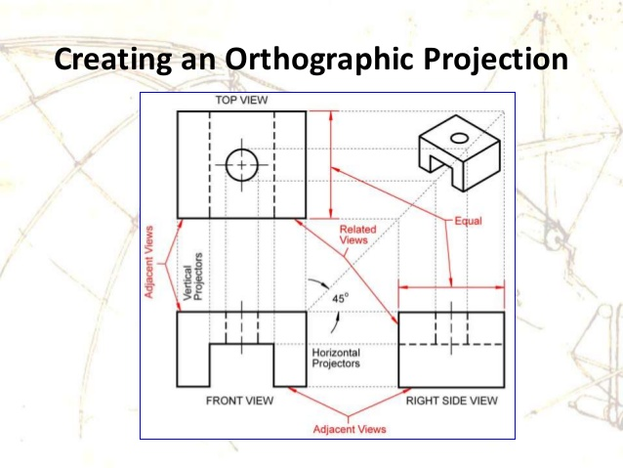
TASK 8:
ORTHOGRAPHIC PROJECTION OF DESIGN
Using your 3D CAD drawing, take a image from the TOP, SIDE and FRONT and place it below to make an orthographic drawing. Add your dimensions or measurements on for a higher level.

Slide 32
ASSESSMENT CRITERIA & TEACHER MARK
Criterion B: Developing Ideas
i. develop a design specification which outlines the success criteria for the design of a solution based on the data collected.
ii. present a range of feasible design ideas, which can be correctly interpreted by others
iii. present the chosen design and outline the reasons for its selection
iv. develop accurate planning drawings/diagrams and outline requirements for the creation of the chosen solution.
Criteria | Tasks | 1-2 | 3-4 | 5-6 | 7-8
i. develop a design specification which outlines the success criteria for the design of a solution based on the data collected. | Task 4 | i. lists a few basic success criteria for the design of a solution | i. constructs a list of the success criteria for the design of a solution | i. develops design specifications, which identify the success criteria for the design of a solution | i. develops a design specification which outlines the success criteria for the design of a solution based on the data collected
ii. present a range of feasible design ideas, which can be correctly interpreted by others | Task 5 | ii. presents one design idea, which can be interpreted by others | ii. presents a few feasible design ideas, using an appropriate medium(s) or explains key features, which can be interpreted by others | ii. presents a range of feasible design ideas, using an appropriate medium(s) and explains key features, which can be interpreted by others | ii. presents a range of feasible design ideas, using an appropriate medium(s) and annotation, which can be correctly interpreted by others
iii. present the chosen design and outline the reasons for its selection | Task 6 | iii. outlines one reason for choosing the design with reference to the design specification | iii. outlines the main reasons for choosing the design with reference to the design specification | iii. presents the chosen design and outlines the main reasons for its selection with reference to the design specification | iii. presents the chosen design and outlines the reasons for its selection with reference to the design specification
iv. develop accurate planning drawings/diagrams and outline requirements for the creation of the chosen solution. | Task 6 Task 7 Task 8 | iii. creates incomplete planning drawings/diagrams. | iv. creates planning drawings/diagrams or lists requirements for the chosen solution. | iv. develops accurate planning drawings/diagrams and lists requirements for the creation of the chosen solution. | iv. develops accurate planning drawings/diagrams and outlines requirements for the creation of the chosen solution.
Teacher’s Comment

Slide 33
Creating the solution
Criterion C:

Slide 34
AREAS OF ASSESSMENT
Criterion A:
Inquiring and Analysing
iii. analyse a group of similar products that inspire a solution to the problem
iv. develop a design brief, which presents the analysis of relevant research.
Criterion B:
Developing Ideas
i. develop a design specification which outlines the success criteria for the design of a solution based on the data collected.
ii. present a range of feasible design ideas, which can be correctly interpreted by others
iii. present the chosen design and outline the reasons for its selection
iv. develop accurate planning drawings/diagrams and outline requirements for the creation of the chosen solution.
Criterion C:
Creating the Solution
construct a logical plan, which outlines the efficient use of time and resources, sufficient for peers to be able to follow to create the solution
ii. demonstrate excellent technical skills when making the solution
iii. follow the plan to create the solution, which functions as intended
Criterion D:
Evaluating
ii. explain the success of the solution against the design specification
iii. describe how the solution could be improved

Slide 35
TASK 9: PLAN FOR MAKING A BOBBLE-HEAD
Create a step-by-step plan of how you create a Bobble-head and what tools you need to use. Illustrate each stage with a sketch and explain the step. The more detail you go into the higher level you will get. Make sure to include the 3D software stage. You could do steps for this also.
?
1
2
3
What do you do?
How do you do it?
What tools do you use and how long does it take?
What do you do?
How do you do it?
What tools do you use and how long does it take?
What do you do?
How do you do it?
What tools do you use and how long does it take?
4
5
6
What do you do?
How do you do it?
What tools do you use and how long does it take?
What do you do?
How do you do it?
What tools do you use and how long does it take?
What do you do?
How do you do it?
What tools do you use and how long does it take?

Slide 36
TASK 10: CREATING THE SOLUTION
(BODY AND 3D PRINTED HEAD)
Using a camera or your smartphone camera take images of your prototype Bobble-head once you have made it using modelling clay and it has been printed in the 3D printer. Then place the pictures below:
IMAGES OF YOUR BODY MADE USING MODELLING CLAY GO HERE
IMAGES OF YOUR HEAD USING MESHMIXER GO HERE

Slide 37
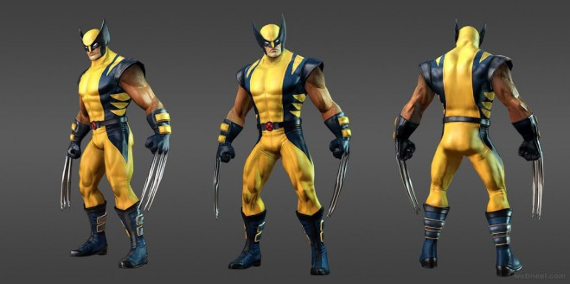
TASK 11: FINAL DESIGN
Present 3 final images of your final product from 3 different angles. Make sure the images look really attractive and sells your Bobble-head well!.

Slide 38
ASSESSMENT CRITERIA & TEACHER MARK
Criterion C: Creating the Solution
construct a logical plan, which outlines the efficient use of time and resources, sufficient for peers to be able to follow to create the solution
ii. demonstrate excellent technical skills when making the solution
iii. follow the plan to create the solution, which functions as intended explain changes made to the chosen design and the plan when making the solution.
Criteria | Tasks | 1-2 | 3-4 | 5-6 | 7-8
i. construct a logical plan, which outlines the efficient use of time and resources, sufficient for peers to be able to follow to create the solution | Task 9 | i. outlines a few steps in a plan that contains some details, resulting in peers having difficulty following the plan to create the solution | i. outlines each step in a plan that contains some details, resulting in peers having difficulty following the plan to create the solution | i. constructs a plan, which considers time and resources, sufficient for peers to be able to follow to create the solution | i. constructs a logical plan, which outlines the efficient use of time and resources, sufficient for peers to be able to follow to create the solution
ii. demonstrate excellent technical skills when making the solution | Task 10 Task 11 | i. demonstrates minimal technical skills when making the solution | ii. demonstrates satisfactory technical skills when making the solution | ii. demonstrates competent technical skills when making the solution | ii. demonstrates excellent technical skills when making the solution
iii. follow the plan to create the solution, which functions as intended | Task 11 | ii. creates the solution, which functions poorly and is presented in an incomplete form. | iii. creates the solution, which partially functions and is adequately presented | iii. creates the solution, which functions as intended and is presented appropriately | iii. follows the plan to create the solution, which functions as intended and is presented appropriately
Teacher’s Comment

Slide 39
Evaluation
Criterion D:

Slide 40
AREAS OF ASSESSMENT
Criterion A:
Inquiring and Analysing
iii. analyse a group of similar products that inspire a solution to the problem
iv. develop a design brief, which presents the analysis of relevant research.
Criterion B:
Developing Ideas
i. develop a design specification which outlines the success criteria for the design of a solution based on the data collected.
ii. present a range of feasible design ideas, which can be correctly interpreted by others
iii. present the chosen design and outline the reasons for its selection
iv. develop accurate planning drawings/diagrams and outline requirements for the creation of the chosen solution.
Criterion C:
Creating the Solution
i. construct a logical plan, which outlines the efficient use of time and resources, sufficient for peers to be able to follow to create the solution
iii. follow the plan to create the solution, which functions as intended explain changes made to the chosen design and the plan when making the solution.
iv. present the solution as a whole
Criterion D:
Evaluating
ii. explain the success of the solution against the design specification
iii. describe how the solution could be improved

Slide 41
TASK 12:
EVALUATION AGAINST SPECIFICATION
Use the table below to evaluate your product against your design specification from slide 14.
Design Specification points | Did your final design meet the specification point? | How can the design be improved to meet the success criteria

Slide 42
TASK 13: EVALUATION
Answer the following evaluation questions below about your Bobblehead monster below in as much detail as possible. A more detailed answer with explanations of how and why will get you a higher level.
What skills did you use when designing your Bobblehead figurine? Explain briefly how you designed your crazy house and why you did what you did?
Did you have any problems whilst making your 3D Bobblehead? Explain them in detail and how you overcame them?
What are the best things you like about your design? Explain why? You can talk about the following:
Aesthetics and Colour:
Quality finish:
Function:
Size:
Material:
How could you improve your design if you were to do it again?
Aesthetics and Colour:
Quality finish:
Function:
Size:
Material:
How do you think you performed in this project overall?

Slide 43
ASSESSMENT CRITERIA & TEACHER MARK
Criterion D: Evaluation
ii. explain the success of the solution against the design specification
iii. describe how the solution could be improved
Criteria | Tasks | 1-2 | 3-4 | 5-6 | 7-8
ii. explain the success of the solution against the design specification | Task 12 | ii. states the success of the solution. | ii. outlines the success of the solution against the design specification based on relevant product testing | ii. describes the success of the solution against the design specification based on relevant product testing | ii. explains the success of the solution against the design specification based on authentic product testing
iii. describe how the solution could be improved | Task 13 | iii. states the ways in which the solution could be improved | iii. lists the ways in which the solution could be improved | iii. outlines how the solution could be improved | iii. describes how the solution could be improved
Teacher’s Comment

Slide 44
FINAL ASSESSMENT MARK
Criterion A:
Inquiring and Analysing
iii. analyse a group of similar products that inspire a solution to the problem
iv. develop a design brief, which presents the analysis of relevant research.
Criterion B:
Developing Ideas
i. develop a design specification which outlines the success criteria for the design of a solution based on the data collected.
ii. present a range of feasible design ideas, which can be correctly interpreted by others
iii. present the chosen design and outline the reasons for its selection
iv. develop accurate planning drawings/diagrams and outline requirements for the creation of the chosen solution.
Criterion C:
Creating the Solution
i. construct a logical plan, which outlines the efficient use of time and resources, sufficient for peers to be able to follow to create the solution
iii. follow the plan to create the solution, which functions as intended explain changes made to the chosen design and the plan when making the solution.
iv. present the solution as a whole
Criterion D:
Evaluating
ii. explain the success of the solution against the design specification
iii. describe how the solution could be improved
Total mark out of 8:

